Slide 1

INTERNSHIP REPORT 2023
MARSHMALLOW
Time Period: 6 weeks
JULY18,2023 – SEPTEMBER 4,2023
Submitted To:- Ma’am Ayesha Mirza
Submitted By:- Amna Malik
Registration Number:- FA20-BMC-043
Media and Communication Studies, Department of Humanities COMSATS University Islamabad, Lahore Campus.

Slide 2
Internship Undertaking
I, Amna Malik, a student of the media and communication studies department of COMSATS
University Islamabad Lahore Campus, under the student ID FA20-BMC-043, solemnly declares that I have completed my internship as a compulsory part of my BS program in my seventh (7th) semester. I completed my six-week internship at Marshmallow Advertising Agency in the social media department. I was enthusiastic about embracing fresh experiences and actively sought opportunities to acquire knowledge and venture into uncharted territories.
I hereby present this report, which primarily highlights my learning experience from the workshop with various departments, the organizational working environment, and observations made during my internship period. I have made an effort to elaborate on all significant aspects that I encountered throughout my internship.
I can confirm that my report is free of any plagiarized content, with the exception of important information related to the organization. All sources used in the report are listed in the reference section at the end. If you require further details, please do not hesitate to ask.
……………….
Amna Malik
ID: FA20-BMC-043
BS in Media and Communication Studies COMSATS University Islamabad, Lahore campus.
Internship Certificate:

Slide 4
Acknowledgments
I would like to take this opportunity to express my heartfelt appreciation and extend special thanks to Yousaf Rashid, the Chief Executive Officer at Marshmallow Advertising PVT. LTD. Despite his busy schedule, he generously provided guidance, and support, and allowed me to pursue my internship at their esteemed organization. His valuable mentorship has been instrumental in keeping me on the right track throughout the training period.
I would like to express my sincere gratitude to Ma'am Madiha, the Social Media Manager of Marshmallow, for her invaluable support and guidance throughout my internship. She played an integral role in decision-making and provided me with necessary advice. I made arrangements to ensure that I had all the facilities needed to make my learning experience at DP comfortable and enjoyable. Most importantly, her mentorship helped me prove myself worthy of being offered a placement. I am truly grateful for her contribution, including the lectures and precious production-related documents that she shared with us.
I would like to extend a special thanks to SIR Sohail Riaz Rajah, the founder and in-charge of Media and Communication Studies, for his invaluable guidance that helped me find my perfect career path. I am also grateful to Ma'am Ayesha Mirza, my lecturer, who provided me with continuous support and guidance throughout my internship journey. Her industry referrals were particularly helpful in securing a placement that met industry standards.
Amna Malik

Slide 5
Executive Summary:
This report provides an overview of my six-week internship at Marshmallow advertising agency Lahore, a full-service advertising agency that collaborates with brands worldwide. During my internship, I worked in various departments to gain practical experience and understand their significance and interconnection. As I aspire to pursue a career in social media, I worked in the Social Media Management department to improve my writing skills and in the Art department to learn design skills using Photoshop. I also worked in the Digital department to learn about strategies for platforms like Facebook and Instagram, while the Client Service department taught me about their crucial role in advertising agencies. Additionally, I learned editing skills in the Production department and important industry terms in the Media department. I worked on various tasks, including creating an annual calendar for Master Bus Service, conducting research for documentaries and campaigns, and designing posts to persuade a new client, Nisa Beauty. This internship provided me with valuable skill sets and insights into how advertising agencies operate, helping me pursue my passion for social media as a future career.
Table of Contents
Contents
Internship Undertaking ................................................................................................................... 2

Slide 6
Internship Certificate:- ................................................................................................................. 3
Acknowledgments:- ........................................................................................................................
4
Executive summary:- ....................................................................................................................... 5
Table of Contents:- ....................................................................................................................... 5
Overview of the Organization:- ........................................................................................................ 8
History:- ........................................................................................................................................ 8
Mission:-..................................................................................................................................... 8
Vision 2027:- …….……...…………....................................................................................... 8
Core Values:- ................................................................................................................................ 9
Market Standing Competitors:-................................................................................................. 10
Services Available: ...................................................................................................................... 10
Brands in collaboration:- ............................................................................................................. 12
Competitors:- ……………………………………………………………………………………
15
Head Office: .................................................................................................................................. 17
Plan of internship:-...........................................................................................................................
17
Departments:-...............................................................................................................
17

Slide 7
Reflective Journal: ........................................................................................................................ 21
Work Samples: .............................................................................................................................. 34
Critical Analysis:
.................................................................................................. 36
SWOT Analysis: ........................................................................................................................... 38
Conclusion: ................................................................................................................................... 38
Recommendations: ........................................................................................................................ 41
References:- ……………………………………………………………………………………… 43

Slide 8
Overview Of The Organization
History:-
Marshmallow is a creative advertising and marketing agency. Creativity, Innovation, and Passion are the beauty of the Marshmallow team.
Marshmallow Advertising (Pvt.) Ltd. was laid out to get a change in the advertising business. In the midst of all the mayhem of purported 360 organizations, we represent specialization and are experts in what we do.
We certainly have practical experience in our administrations. Check us out is allow your image an opportunity to succeed.
Consider us the last unaccounted-for part of the riddle of your image creation. Our group contains little gatherings, every one of which represents considerable authority in specific abilities and they cooperate to execute smart courses of action to accomplish hierarchical objectives and give substantial outcomes to the organizations related to us.
Till now, we have assisted in excess of 500 organizations with making progress in arriving at their ideal interest group as well as changing over their leads into paying clients. Go along with us and become the champ you generally need to be.
MISSION:-
At Marshmallow, we mean to characterize brands by featuring their uniqueness and separating them from their rivals. This expects us to completely investigate the market, plan innovative showcasing efforts, pick the right media stage, and make practical media plans.
VISION 2027:-
To turn into the #1 advertising agency in Pakistan that gives 100 percent consumer loyalty and substantial outcomes to developing organizations.

Slide 9
CORE VALUES:-
Our basic beliefs are what separate us from our rivals. They are the justification for all the achievements we have yet accomplished and it is because of them we will continue improving and getting better consistently. Here are our fundamental beliefs that we strictly follow and never think twice about them Diligence: Perseverance is the way to outcome in each field of life. Little reliable endeavors in the right course generally lead to great outcomes.
Reasonableness: Decency at work means a lot to elevate the spirit of each and every representative. We have confidence in the fair and equivalent treatment of everybody with next to no segregation of doctrine, variety, or orientation.
Responsibility: Each colleague is mindful and takes responsibility for their activities. It takes boldness and trustworthiness to consider yourself responsible and that is the thing we endeavor to impart to our representatives.
Variety and incorporation: We invite individuals from various different backgrounds to our group. This permits us to take the influence of each and every gifted and capable individual and gain from them.
Artistic liberty: Without artistic liberty, imagination can't exist. We urge our kin to articulate their thoughts openly with practically no apprehension about judgment. Inventiveness wins where free reasoning is permitted.
Cooperation: Each colleague cooperative endeavors toward accomplishing a shared objective for example giving outcomes to our clients.

Slide 10
Market Standing and Competitors
Marshmallow Advertising Agency is one of the main advertising organizations in Pakistan. They have major areas of strength for standing and are known for their imaginative and inventive way of dealing with advertising. They have a great many clients from different businesses and have effectively executed various missions. As far as contenders, a portion of the significant advertising organizations in Pakistan incorporate Ogilvy and Mather, BBDO Pakistan, and JWT Pakistan.
Services Available:-
Media planning and buying:-
Print Media
Electronic Media
Digital Media
Media Planning
Budgeting
2. Creative Design:-
Packaging Design
Logo Design
Brand Identity
Campaign Development
Branding and Merchandising
Digital Marketing:-
Digital marketing is an efficient marketing strategy to achieve a targeted audience and interact with them to require any action when running a digital selling campaign.

Slide 11
4. 2D/3D Animation:-
2D/3D Animation
Product Animation
Character Animation
Arcitatial Animation
2D/3D Modeling
TVC/DVC Prodution:-
Explainer Videos
TVC/DVC Production
Documentart Production
Shooting
Creative Conception
6. Documentory Production:-
Planning
Script Writing
Production
Editing
Approval

Slide 12


Brands Marshmallow Collaborate With:-
Road Master:-
Review from Road Master:–
It was hard to find who was well-rounded in all areas of digital marketing. It is a fantastic digital agency in Pakistan working with all innovative techniques. Now, I have no headache in running my digital campaigns on social media platforms.
Iffat Anwer Medical Complex:-
Review from Iffat Anwer:-
Marshmallow Advertising has a team of professionals who understand the latest technologies and have solutions for all digital needs. They always deliver quality work with on-time delivery. From website development to content creation, they can help you ensure your business is found in search.

Slide 13


Eithad Town:-
Review from Eithad town:-
These guys are incredibly talented and reliable. They always go above and beyond for us. Their work is fantastic and they make a great team together. Would highly recommend it for all your development and digital marketing needs.
Nisa Cosmetics:-
Review from Nisa Cosmetics:–
Get inspired by the team of Marshmallow. They take care of whatever I need for digital marketing by performing great. I took social media services and they impressively work done. They are always optimistic and focused on the task at hand.

Slide 14


ZandJ:-
Review from ZandJ:-
A company with well-organized staff and appreciated service. I believe they are one of the best marketing agencies in Lahore. They are optimizing my social media network and I am satisfied with the result.
Master Baby:-
Review from Master Baby:-
Marshmallow Advertising is a high-quality, full-service digital agency. They have professionals who understand the latest technology and have solutions for all my digital needs. They knew our deadlines and told us what we needed to do to hit them. Perfect place for Digital marketing and Web development. Overall great experience.

Slide 15
Competitors:-
“eChromatics Web Solutions
Lahore, Pakistan:-”
Their claims:-
eChromatics is a company that provides a variety of value-added services, such as website design, development, SEO optimization, and digital marketing services. We specialize in web development services, including website design, web application development, and e-commerce development, among others. Our services are customized to meet the unique needs of each client and their business requirements.
We also offer affordable web hosting solutions for businesses of all sizes. Our team of experts has years of experience in the web hosting industry, ensuring that your website operates smoothly and securely. We provide a range of hosting packages, from shared hosting for small businesses to dedicated servers for larger enterprises. All of our packages include a 99.9% uptime guarantee, daily backups, and WhatsApp support to ensure the safety and security of your data.
“Codiveo
Lahore, Pakistan”
“Their Claims”
Codiveo is a company that is enthusiastic about utilizing its expertise and innovative solutions to empower businesses and drive their success. We are committed to excellence and a client-centric approach, ensuring that we deliver exceptional results that surpass expectations and make a long-lasting impact in the digital landscape.
Our mission is to provide the best insurance value for consumers by combining aggressive strategic marketing with quality products and services at competitive prices.
We offer a range of services, including web development, app development, graphic designing, digital marketing, and search engine optimization.

Slide 16
Xcentric Services
Lahore, Pakistan
“Their claims:-”
Xcentric Services is a technology agency located in Lahore, Pakistan that specializes in Social Media Marketing, ERP, CRM, creative, technology, and e-commerce. We help brands create exceptional assets and provide distribution platforms to engage with their customers and share their stories.
We offer a suite of services, including large-scale ERP solutions, e-commerce creations for digital campaigns, technology consultancy, website development, web design, e-commerce, CRM, digital marketing & SEM, and branding. We collaborate with clients in various industries such as fashion, luxury, finance, food and beverage, lifestyle, technology, and academics.
At Xcentric, we are renowned for delivering tangible results through strategic implementations and conceptual and strategic design. Our clients appreciate that we don't simply plan, build, or deploy solutions – we stay in to activate, maneuver, optimize, and further foster them.
2BTech
“Their Claims:-”
2BTech is a digital marketing agency that aims to connect the global community by building trust and providing long-lasting services. We established our company in 2019 with a belief that strategic and conceptual thinking is essential to fully comprehend brand challenges and provide insight-led solutions. Since then, we have successfully served numerous clients worldwide.
Our primary skills include digital marketing, web designing & development, and mobile application development. We strive to become a marketing partner for our clients by creating awareness, increasing their sales, and meeting their specific standards through mutual understanding. Our goal is to ensure the success of our clients.

Slide 17
Head Office:-
16, Block M Johar Town, Lahore. 3rd Floor، Caesar's Tower Office #309, Main Shahrah-e-Faisal, opposite Fowler Lines, Karachi.
Plan Of Internship:-
Organization of the internship:-
I have done my six-week temporary position to learn web-based entertainment improvement at Marshmallow (PVT) LTD Lahore, which is a famous advertising agency. Marshmallow is a full-house agency that offers every one of the online entertainment improvement offices to its business clients.
Duration Of Internship:-
The duration of my internship was from July 18, 2023, to September 4, 2023.
Departments of Training:-
Creative Department:-
The principal office I got prepared in was the innovative division. I figured out the way this functions and worked on copywriting and other significant things about advertising. I burned through one and a half weeks in the innovative division.
Workmanship Department:-
After the inventive division, I worked in the craftsmanship office on the grounds that the Inventive and workmanship divisions work intently. There I found out about how thoughts are executed in an imaginative manner. I spent around two days there and found out about the rudiments of Photoshop.
Creation Department:-
After the workmanship division, I moved to the creation office to find out about liveliness and video altering. I burned through two days there to grasp the way this functions.
Computerized Department:-
I burned through multiple weeks in the computerized division to find out about systems of various online entertainment stages and I planned various missions keeping in view everything that I have learned in this division.
Media Department:-

Slide 18
I spent some in the Media division to learn office work since it is the significant part where the agency delays and space for notice and manages charging.
CS Office:-
Preparing System:-
Promoting office:-
The Promoting Office is the main department in this organization since Advertising individuals acquire new business and offer types of assistance to existing clients. There are two sub-branches of the Advertising Division
• Client administrations
• Business improvement
The point-by-point work of the client administration Department:-
The client care division is a nearby contact with the client for a smooth trade of data and backing. The client support division is an extension between marshmallow Advertising and the client. Every client assistance chief has a particular client they work for so they can zero in on specific records and perform well.
The point-by-point work of the business advancement Department:
The Business Improvement division is liable for laying out and drawing in new clients to the market; they watch out for the market circle of chances to have the option to present new clients on time through proper introductions on marshmallow advertising. So from that point onward, assuming the client shows interest in it, they will request media expenses in the event that they need to run their promotions in the paper, if not they will request the full media plan.
Imaginative Department:-
The representatives of this division are the scholarly creators of this association. The job of this division is to give the item a brilliant touch. Their workers are accomplished. They are liberal, tolerant, and have extraordinary relational abilities.
The nitty gritty work of the imaginative branch of Marshmallow Advertising:
Advertising is close to nothing without innovativeness this imagination requires workmanship and a strong technique.

Slide 19
At Marshmallow Advertising, the innovative head, helped by a craftsmanship chief, drives the imaginative office. The marketing specialist is advised about the item, the opposition, and other significant components by the client administration division then the author gets ready with different choices as indicated by the prerequisites of the client. Marshmallow Advertising has both Urdu and English marketing specialists who compose the body text of the commercials.
Computerized Office:-
The point-by-point work of the Advanced branch of Marshmallow Advertising:
Advanced notice has become vital in the period of digitalization on the grounds that each business needs to guarantee its computerized presence. In marshmallow, Advanced advertising heads and social media supervisors work to foster powerful methodologies and they likewise configure crusades equivalent to print for web-based entertainment. They likewise work with the craftsmanship office to execute their thoughts.
Workmanship Division:-
The nitty gritty work of the Craftsmanship Division of Marshmallow Advertising:-
The craftsmanship chief recommends how the thought ought to be introduced in a one-of-a-kind and creative way. What ought to be remembered for the promotion, and how do these things enhance the item? That's what they imagine in the event that the thought is introduced in a basic manner it would be more compelling and could give the necessary outcomes. Fashioners give thought to a structure that should be visible.
The workmanship chief advised them about the visuals for the expected promotion. Fashioners set up an unpleasant plan and apply a different variety of plans. They conclude what the foundation ought to be and what variety of plots it upholds. In the event that the picture or photo of the item is expected for a particular promotion, the in-house photographic artist shoots it.
Creation Office:-
The nitty gritty work of the creation Division of Marshmallow Advertising:
It is perhaps the main division, where the ideas/thoughts showed signs of life. This division involves assets like NLE Editors, and Illustrators, alongside Cameraman, Creation Chief, and Creation Chief. It is one of the innovative divisions, which works with the aggregate exertion of client support, and imaginative offices with the coordination of the Creation Chief to get the ideal outcomes.

Slide 20
Media Office:-
The media office assumes a significant part in Marshmallow advertising. They give a connection between the media and Marshmallow advertising. The division is going by a senior supervisor who is helped by a chief for each sort of medium. The media office intently screens print and electronic media. This division has all the data connected with each sort of medium. This division handles the undertakings of the media and its connected fields. All item that has been recently delivered by the association is connected through the media staff. Individuals in this office are capable of media information and data. The primary issues are connected with the distribution of promotions in the predefined papers.
Elements of the Media Division at Marshmallow Advertising:-
Every one of the above things are remembered for the media division. The media division carries out different roles and they are answerable for choosing the right kind of media relying upon the necessities of the general population/confidential area client.
Broad elements of the media division:-
➢ Media research
➢ Media technique advancement ➢ Media planning
➢ Media purchase
➢ Placement
➢ Charging
Reflective Journal:
Date | Day | Task Performed | Description | Interpret | Evaluation | Plan

Slide 21
July 18 2023 | Tuesday | They introduced us to the team members there. And gave us a visit of the office. We sat together with Ma’am Madiha and she took our interview. | Team members were very helpful and it was a very friendly environment. All the employees there were very young so we clicked very well and it was a great experience. Ma’am Madiha asked us about our major and all the details about our future plans. | I was very happy meeting new and very proficient and skillful people. I replied all the questions Ma’am Madiha asked confidently. | Our team members were very happy to see how we were interacting with all the members with all due respect. Ma’am Madiha loved how I answered all the questions and she was happy with my answers and my broad perception of this industry. | Everything was good but the office building was very small it didn’t feel like an office. There was no location on Google and they made us wait for 2 hours before meeting us.
July 19 2023 | Wednesday | Sat and discussed all the clients Marshmallow has. | Ma’am Madiha and Sir Saqlain sat with us and showed us all their clients online and made us follow all their socials. | Understanding how each client works and what are their requirements was very easy because of our mentors. | They gave their remarks at the end of the session and they said:” You guys did a great job understanding all the clients now we want enthusiasm and great work effort.” | They should use projectors instead of holding mobiles because projectors help to keep our focus.

Slide 22
22 July 2023 | Saturday | Meeting with the boss. August calendar for baby master. | We had a meeting with the boss where he asked about the work that we have understood till now. After that, we made an August calendar for master baby. We looked at many different calendars and in the end finished our calendar with the help of Sir Saqlain. | I finally now know how social media managers can post interesting posts daily. They have a plan for the upcoming month and this helps them to have a great post everyday. | At first, he had to tell us 2-3 times how things work but then we made it and he loved it. | It is not at all difficult but no doubt it is very difficult to understand every detail about all the clients. But if they had different rooms for different departments it would be much easier.

Slide 23
25 July 2023 | Tuesday | Took a look into the creative department. Wrote script for ad for government on smog. | The creative department head explained to us how to write the script for the ad and that they had to get approval from the Punjab government. It was very easy and interesting. | I wrote the ad with the help of my classmate it took us some time to make an effective and eye-catching script. | Sir was very impressed with how we wrote such an amazing script. He gave us more work not for the office but to train us and that we had to complete from home. | Creative room was very small and had nothing to keep people entertained and focused it was where as I think that creative room should have such interior that keeps people focused to the work.

Slide 24
26 July 2023 | Wednesday | Made persuading posts for Nisa Beauty with Ma’am Errum. | Ma’am Maira gave me a task to make posts to persuade Nisa Beauty. She told me to get help with ideas from different accounts and I did the same It took me a while to create all the posts and then I explained that to the editor and he helped me to bring my idea in reality. | For me, it was a great opportunity to prove myself and I tried my level best to do so. I took help from various areas and designed Instagram posts surprisingly it was not as difficult as I thought it was. It was very good for me to put my ideas into reality. | Ma’am Errum loved my work she was so impressed that she sent it for approval and surprisingly it was approved. She was so impressed that she took me for lunch on lunch break that day to One Potato, Two Potatoes. | As I said before everything is perfectly fine except that there are no specific rooms to perform tasks.
29 July 2023
Saturday
Muharram
holiday

Slide 25
1st August 2023 | Tuesday | Made taglines. | We made taglines for posts of Etihad Town. Making taglines is not that easy. It is a very time-consuming kind of work that involves all the attention and a lot of concentration. We can definitely take help from different online websites but we can not rely on anyone them 100%. | It was not interesting at all. Because we wanted to learn different things but we have always made so many taglines in our university that now making 100 taglines was very boring. | They liked our work because we knew how to make tag lines and it helped them a lot Half of their work was done by us and they loved it. | Making taglines was very boring we were there to learn new things but there weren't any new things.

Slide 26
2nd August 2023 | Wednesday | Made taglines and had a little bit knowledge about how they make ads | Learned that they do not do any shooting stuff they just do all the editing. We found videos from YouTube and other websites and sent them to the editors. They combined them added music and explained the process. | I liked how it is very different from what we think making ads is. Getting knowledge about new things is very interesting. | they were very friendly and answered our questions as many times as we needed them. They helped us a lot in making the taglines look better. And they also explained each and everything about editing ads. | As told before very less area to perform all the tasks.

Slide 27
5th August 2023 | Saturday | Meeting with boss. Script writing. | We had a meeting with our boss he asked us how is everything going on we clicked pictures with him and at the end, he described how this industry works. Then we wrote a jingle for Road Master. | Meeting with Sir Yousaf was great as we learned a lot about different aspects of life not only work but also about life. After our meeting, we wrote 1 jingle for Road Master busses for their TV commercial. Writing for Road Master was a great opportunity because they are one of the biggest clients of marshmallow. | Ma’am Errum was leading us with that and she loved it. Her great words were a great help for all of us. | Everything was perfectly fine.

Slide 28
8th August 2023 | Tuesday | Watching best TVCs and analyze its content | Best Pakistani ads of all time mainly focused on how some of them are Thought-provoking and emotionally connected to their audience. Content is now designed based on the liking of youth we can also say that trendy things are more appealing if they are presented beautifully. | It was not something new to watch TV commercials but being observant is something new I have learned. It is necessary to focus on each point. | I realized how brands are now using the approach of adding human interest in their product-selling campaigns. Culture should be the main priority While designing any campaign a good advertiser should also keep in view values, ethics, and religious factors. | In the future if I am going to be in an advertising agency it's necessary to remember these certain points because your sixer can bounce back at any time.

Slide 29
9th August 2023 | Wednesday | Marketing strategies and segments | I read blogs and articles related to marketing strategies and how it is important to know about your marketing strategy before launching any brand. | I know marketing strategies were important but I thought it was planned after the brand's logo, tagline, etc. Another point was how you should know about unique selling points because it is what is going to make an exception. | I realized that before you know you want to launch a brand; you should know what marketing strategy you are going to use. | No doubt it’s going to Help in future.

Slide 30
12th August 2023 | saturday | Logo designing and its ideas. | Like any other task research is the key. I studied different brand logo and the rationale behind that Logo. | 1.I always thought that some logo is without any rational but there is complete science behind their logos like Apple, Amazon, Audi etc. | It is important to study every market but focus on the market where people have same mentality as you like I was told time and again to always study Indian market first. | It was a new thing to learn. It is also the part of creativity and it was really fun to learn.
15th August 2023 | tuesday | Ideas about grid and knowing about ad. Size and types of TVCs. | I looked at different layout to get the idea about grid design. I also came to know about different ad sizes and types of TVCs | It was yet another new thing to learn but I struggle in this task because I never work in this area of field but other task were somewhat familiar to me. | It is also part of creativity. Like to have good knowledge of design and your aesthetics should also be very refined for this task. | In future as an professional these things will be very helpful.

Slide 31
16 August 2023 19th August 2023 | wednesday Saturday | Study about digital marketing and its strategies and where they are applicable Studying how PR is used in Advertisement agency. | Importance of digital media nowadays, its types and how they are being used in our daily life to grab customer’s attention and how strategies are important to make a campaign successful PR is the base of an agency because they are the one who builds relationship with client and satisfy clients by their work as an agency. In agency this work as Client servicing department. | It's another thing to learn on the grounds because I was just familiar with term digital marketing but now I had just found out what digital marketing is in detail. Its details were significant and new to me. PR is the strategic communication between organization and its public. It is often use to build relationship with client and help them build a great reputation of them in front of their consumers. | I came to realize how digital marketing is important for your entire business because without it no business can get by. Digital marketing is also very crucial in designing strategies for campaign. It helps me finally understand what actually PR is and how it focuses on facts and telling people how good other is. It is not like an advertisement where you pay to sell your product but it is about where you build relationship free of cost. | It was something new to learn and in time of digitalization it has become very important to study it. In future is will help me in practical life. In future as a professional these things will be very helpful. Because PR is a vast field and had many scopes.

Slide 32
22nd August 2023 23rd August 2023 | Tuesday Wednesday | Media planning and buying. It was a rainy day as well as a day full of load shedding. | The task was to know how important media planning is because without media planning your whole campaign no matter how good it is will be zero We didn’t do much of the work but all the work was done in the time frame of 2-3 hours. | I took help from google to know about media planning and I came to know 5Ws; Which, When, what, whom and where Are keys which every media planner should know. The executor buys media on basis of negotiation and good relationship We made posters and gathered plans for billboard design. | There are multiple factors that are affecting media planning process like budget, media image, demographics, nature of message etc. So the executor should keep close eye on these factors because it will take part in making campaign successful. All the workers were enjoying time with their mates. | This media buying and planning is whole different domain of an agency. So, if a person has interest in this area he/she can pursue it. They should work on their generators.

Slide 33
26th August 2023 | Saturday | It was our last day there because they gave us holidays after that. | It was a great day we met everyone and discussed our journey. | They claimed that we are one of the best internees they ever had. | Overall experience was great. | GREAT DAY!

Slide 34
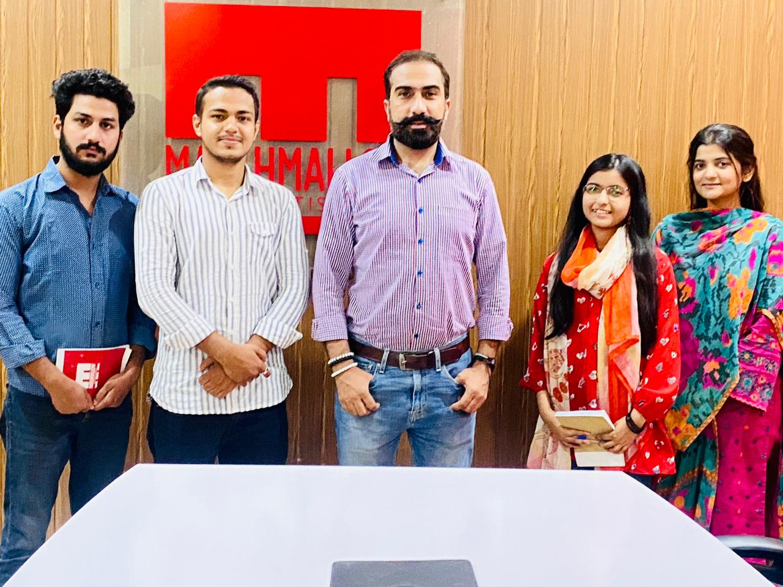
Work Samples:

Slide 35
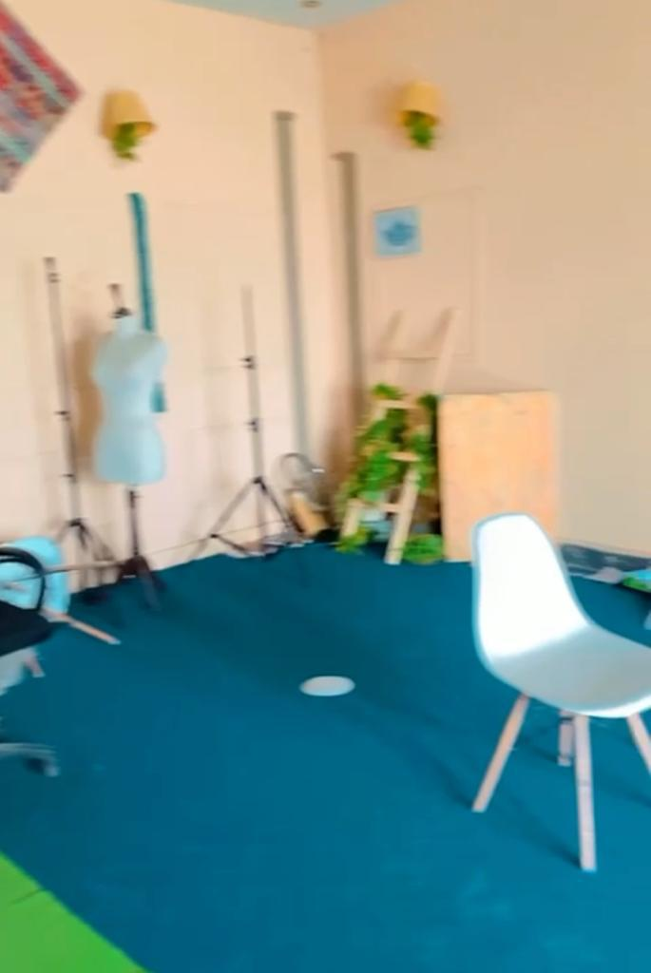
Following are the links to the posts I have worked on:-
https://www.instagram.com/p/CvZ5Arko3RU/?igshid=NmQ4MjZlMjE5YQ==
https://www.instagram.com/reel/Cv5U51tI22f/?igshid=NmQ4MjZlMjE5YQ==

Slide 36
Critical Analysis:
Introduction:-
Advertising agencies play a crucial role in the marketing industry as they help businesses to promote their products and services to the target audience. This critical analysis will focus on Marshmallow Advertising Agency, which is a full-service advertising agency that offers creative marketing solutions to clients across various industries. The analysis will provide an overview of the agency's history, mission, and values, followed by an examination of its approach to advertising, client relationships, and diversity and inclusion.
Overview of Marshmallow Advertising Agency:-
Marshmallow Advertising Agency was founded in 2000 and has since grown to become one of the leading advertising agencies in the country. The agency's mission is to provide innovative and effective marketing solutions to clients while maintaining a high level of professionalism and integrity. The agency's values include creativity, teamwork, transparency, and accountability.
Approach to Advertising:-
Marshmallow Advertising Agency's approach to advertising is based on a deep understanding of the target audience and the client's business objectives. The marshmallow advertising agency's creative team works closely with clients to develop unique and compelling campaigns that resonate with consumers. The marshmallow agency's campaigns are designed to evoke emotions and create a lasting impression on the target audience.

Slide 37
One of the strengths of Marshmallow Advertising Agency is its ability to leverage social media platforms to reach its target audience. The marshmallow advertising agency has a dedicated social media team that develops social media campaigns that are tailored to the needs of each client. The agency also uses data analytics to measure the success of its campaigns and make adjustments as needed.
Client Relationships:-
Marshmallow Advertising Agency places a high value on building strong relationships with its clients. The agency's account executives work closely with clients to ensure that their needs are met throughout the campaign development process. The agency also provides regular updates to clients on the progress of their campaigns and welcomes feedback from clients.
However, one weakness of Marshmallow Advertising Agency is that it can be slow to respond to client inquiries or concerns. This can sometimes lead to frustration on the part of clients who feel that their needs are not being addressed in a timely manner.
Diversity and Inclusion:-
Marshmallow Advertising Agency has made a commitment to diversity and inclusion in its workforce and its campaigns. The agency's workforce is diverse, with employees from different racial, ethnic, and socioeconomic backgrounds. The agency also strives to represent diverse perspectives in its campaigns and has developed campaigns that promote inclusivity and equality.

Slide 38
Extensive Network: Marshmallow advertising agencies often have a wide network of industry contacts, including media outlets, production houses, and influencers. This network allows them to negotiate better deals, secure prime advertising spaces, and collaborate with influential partners.
However, the agency could do more to promote diversity and inclusion in its leadership positions. Currently, the agency's leadership team is predominantly male, which could be seen as a barrier for women who aspire to leadership roles within the organization.
Conclusion:-
Overall, Marshmallow Advertising Agency is a well-respected advertising agency that has demonstrated a commitment to providing innovative and effective marketing solutions to its clients. The agency's approach to advertising is based on a deep understanding of the target audience and the client's business objectives. The agency places a high value on building strong relationships with its clients but could improve its responsiveness to client inquiries and concerns. Finally, the agency has made a commitment to diversity and inclusion in its workforce and its campaigns but could do more to promote diversity in its leadership positions.
SWOT ANALYSIS:-
Strengths:
Creative Expertise: Marshmallow Advertising agencies are known for their strong creative teams that possess the ability to develop innovative and impactful campaigns. This creative expertise allows them to deliver compelling messages and engage target audiences effectively.
Strategic Thinking: Marshmallow Advertising agencies excel in strategic planning and market analysis. They have the ability to understand client objectives, identify target markets, and develop comprehensive advertising strategies that align with business goals.
Industry Knowledge: Marshmallow Advertising agencies possess deep industry knowledge and stay up-to-date with the latest trends, consumer behavior, and market dynamics. This knowledge enables them to provide valuable insights and recommendations to clients.

Slide 39
Weaknesses:
High Competition: The advertising industry is highly competitive, with numerous agencies vying for clients' attention. This intense competition can make it challenging for agencies to differentiate themselves and secure new clients.
Limited Resources: Some advertising agencies may face resource constraints, particularly smaller or newer agencies. Limited budgets, manpower, or technological infrastructure can hinder their ability to execute large-scale campaigns or adopt cutting-edge technologies.
Client Dependence: Advertising agencies heavily rely on client relationships and contracts for their revenue. If a major client decides to switch agencies or reduce their advertising budget, it can significantly impact the agency's financial stability.
Evolving Technology: The rapid pace of technological advancements poses a challenge for advertising agencies. Keeping up with emerging platforms, tools, and digital marketing trends requires continuous learning and investment in new technologies.

Slide 40
Opportunities:
Digital Transformation: The shift towards digital advertising presents significant opportunities for agencies to expand their services and reach wider audiences. Agencies can leverage digital platforms, social media, and data analytics to deliver targeted and measurable campaigns.
Niche Markets: Marshmallow can explore niche markets or industry verticals where they have specialized expertise. Focusing on specific sectors allows agencies to position themselves as industry leaders and attract clients seeking specialized services.
Global Expansion: With the rise of remote work and digital communication, Marshmallow agencies can expand their operations globally. Targeting international clients or establishing satellite offices in key markets can lead to new business opportunities.
Collaborations and Partnerships: Forming strategic partnerships with complementary service providers, such as PR firms or digital marketing agencies, can enhance an advertising agency's capabilities and broaden its service offerings.
Threats:
Economic Volatility: Economic downturns or recessions can lead to reduced advertising budgets as businesses cut costs. This can result in decreased demand for agency services and increased competition for a smaller pool of clients.
Changing Consumer Behavior: Shifts in consumer behavior, such as ad-blocking software usage or preference for ad-free content, pose challenges for traditional advertising methods. Agencies must adapt to these changes by exploring

Slide 41
alternative channels or adopting native advertising approaches.
In-House Agencies: Some businesses opt to establish in-house advertising teams to have more control over their campaigns and reduce costs. This trend poses a threat to traditional advertising agencies as it reduces the number of potential clients.
Data Privacy Regulations: Increasing regulations around data privacy and consumer protection impact how agencies collect, store, and use customer data for targeted advertising. Compliance with these regulations can be complex and time-consuming.
Conclusion:
This SWOT analysis highlights the strengths of Marshmallow advertising agencies in terms of creative expertise, strategic thinking, industry knowledge, and extensive networks. However, they face challenges such as high competition, limited resources, client dependence, and the need to keep up with evolving technology. By capitalizing on opportunities like digital transformation, niche markets, global expansion, and strategic collaborations, agencies can mitigate threats arising from economic volatility, changing consumer behavior, in-house agencies, and data privacy regulations. Continuous adaptation and innovation are crucial for advertising agencies to thrive in an ever-evolving industry landscape.
RECOMMENDATIONS:-
Based on the SWOT analysis of an Marshmallow advertising agency, the following recommendations can be made:
Leverage Digital Transformation: Marshmallow Advertising agencies need to embrace digital transformation and leverage digital platforms, social media, and data analytics to deliver targeted and measurable campaigns. Agencies should invest in digital tools and technologies that enable them to track campaign performance, analyze consumer behavior, and optimize campaigns in real-time.

Slide 42
Diversify Service Offerings: Marshmallow Advertising agencies should consider diversifying their service offerings beyond traditional advertising. This could include services such as content creation, influencer marketing, search engine optimization, and website development. Diversifying service offerings can help agencies attract new clients and increase revenue streams.
Focus on Niche Markets: Marshmallow Advertising agencies should consider focusing on niche markets or industry verticals where they have specialized expertise. This allows agencies to position themselves as industry leaders and attract clients seeking specialized services. Agencies should invest in building their knowledge and expertise in specific sectors to differentiate themselves from competitors.
Improve Client Relationships: Marshmallow Advertising agencies should focus on building strong and long-lasting client relationships. This includes providing regular updates on campaign progress, actively seeking client feedback, and ensuring that client needs are met throughout the campaign development process. By improving client relationships, agencies can increase client retention rates and generate positive word-of-mouth referrals.
Invest in Employee Development: Marshmallow Advertising agencies should invest in employee development to retain top talent and stay competitive. This includes providing training and development opportunities, offering competitive compensation packages, and creating a positive work culture that fosters creativity and innovation.
Stay Ahead of Technological Advancements: Marshmallow advertising agencies should stay ahead of technological advancements by continuously learning and investing in new technologies. This includes keeping up with emerging platforms, tools, and digital marketing trends to provide clients with cutting-edge services. By staying ahead of technological advancements, agencies can differentiate themselves from competitors and attract clients seeking innovative solutions.
In conclusion, advertising agencies need to embrace digital transformation, diversify their service offerings, focus on niche markets, improve client relationships, invest in employee development, and stay ahead of technological advancements to remain competitive and successful in the industry.

Slide 43
References:-
https://marshmallowadvertising.com/

